Slide 1
Relational Database Management System
By: Florence Dube-Olajide
Oct. 18th 2024

Slide 2
Objective
Explain the differences between relational and non-relational databases.
Provide a clear and concise explanation of their characteristics, use cases, and advantages.
Understand the key factors to consider when choosing a database for a specific application.

Slide 3
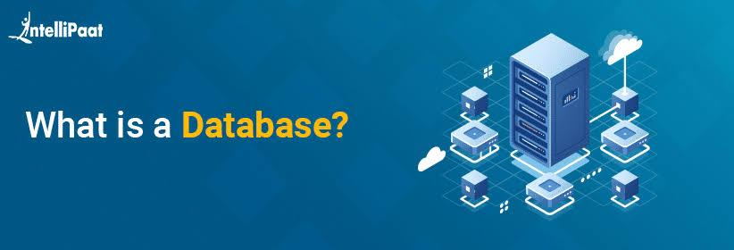
A database is an organized collection of structured information, or data, typically stored electronically in a computer system. A database is usually controlled by a database management system (DBMS).

Slide 4
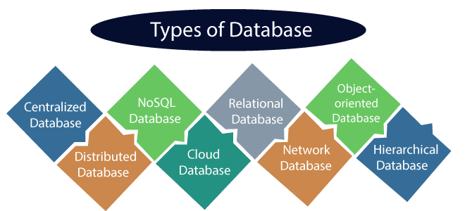

Slide 5
Differences Between Relational and Non-Relational Databases
Relational Databases: Use a structured format to store data in tables with rows and columns. Each table represents a different entity, and relationships between tables are defined through foreign keys.
Non-Relational Databases: Also known as NoSQL databases, store data in a variety of formats (e.g., key-value pairs, documents, graphs) and are more flexible with schema design.

Slide 6
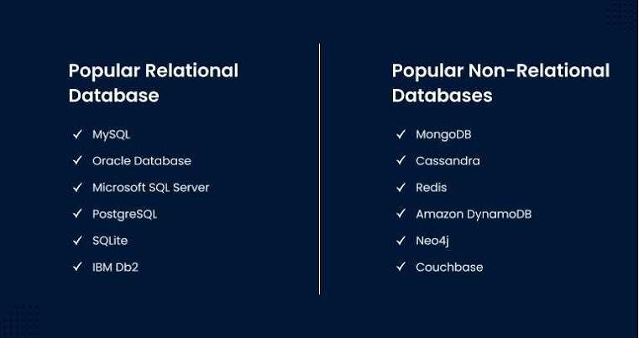
KEY DIFFERENCE BETWEEN RELATIONAL & NON-RELATIONAL DATABASE

Slide 7
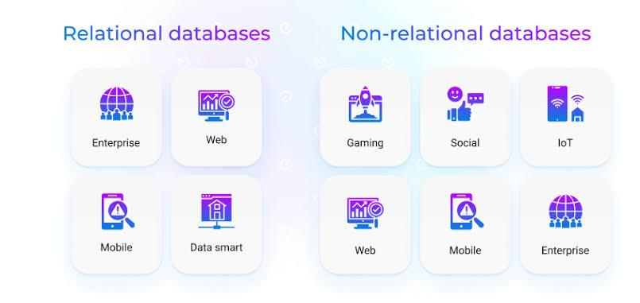
USE CASES OF RELATIONAL AND NON RELATIONAL DATA BASE

Slide 8
Characteristics
Relational Databases:
Structured Data: Data must fit into predefined schemas (tables, columns).
Schema: Rigid structure that defines data types and relationships.
ACID Compliance: Guarantees reliable transactions (Atomicity, Consistency, Isolation, Durability).
Non-Relational Databases:
Flexible Schema: No fixed structure; data can be added without a predefined schema.
Varied Data Models: Supports documents, key-value pairs, wide-column stores, and graph databases.
Eventual Consistency: Focus on high availability and scalability, often trading off immediate consistency.

Slide 9
Relational Databases
Banking Systems: Requires strict data integrity and consistency.
Inventory Management: Well-suited for structured data and complex queries.
Non-Relational Databases
Social Media Applications: Handles varied data types (posts, comments) with high user interaction.
Big Data Analytics: Processes large volumes of unstructured data quickly.
ACTUAL USEFUL CASES

Slide 10
Relational Databases:
Data Integrity: Strong mechanisms for maintaining data accuracy and consistency.
Complex Queries: Advanced querying capabilities using SQL, suitable for complex data retrieval.
Non-Relational Databases:
Scalability: Easily scales horizontally by distributing data across many servers.
Performance: Optimized for high-speed data access and retrieval, especially with large datasets.
Advantages of Relational and Non-Relational Database

Slide 11
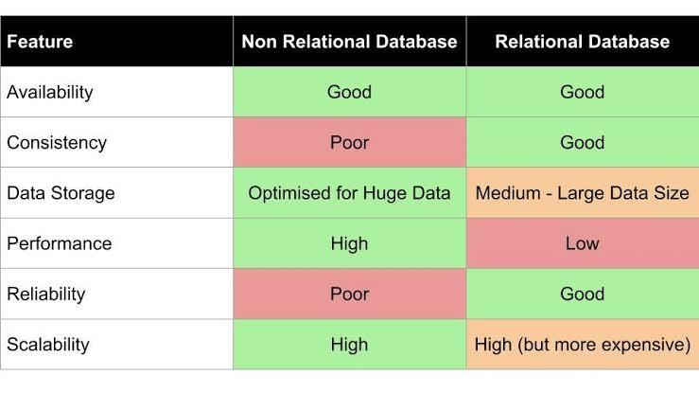
Pros and Cons

Slide 12

Choosing between relational and non-relational databases depends on the specific requirements of your application. If you need strict data integrity and complex queries, relational databases are preferable.
However, if your application demands flexibility, scalability, and can tolerate eventual consistency, non-relational databases may be the better option.
Conclusion

Slide 13

References
IBM: Relational vs Non-Relational Databases
MongoDB: What is a NoSQL Database?
W3Schools: W3Schools SQL Tutorial
TutorialsPoint: NoSQL Databases
https://www.oracle.com/ng/database/what-is-database/
existek.com
graffersid.com
towardsdatascience.com

